Slide 1
Sequential Circuit Latches and Flip-Flops
© Adnan Amin Siddiquee

Slide 2

Difference between Combinational Circuit and Sequential circuit
© Adnan Amin Siddiquee

Slide 3
Contents
Sequential circuit
Triggering of sequential circuit
SR latch
Gated SR latch
J-K flip-flop
D flip-flop
T flip-flop
Preset Clear JK flip-flop
© Adnan Amin Siddiquee

Slide 4
Sequential Circuit
Inputs
Combinational
Circuit
Outputs
Memory
clock
Figure: Block diagram of a sequential circuit
Output depends on present input and past history of the system
Temporary storage device and it has two stable state.
Two type of sequential circuit :
a) Asynchronous : Output changes any time
b) Synchronous : Output changes with clock
Level sensitive (Latch)
Edge triggered (Flip-Flop)
© Adnan Amin Siddiquee

Slide 5
Difference Between level & Edge Triggering
The state of a flip flop is switched by a momentary change in the input signal. This momentary change is called trigger.
There are two type of trigger possible. a)level Tigger b) edge trigger
Positive Level
1
1
0
0
Negative Level
Figure: Level trigger
© Adnan Amin Siddiquee

Slide 6
Edge Triggering of Flip-Flops
Two type of edge trigger.
a) positive edge
b) negative edge
Positive edge means 0 to 1 transition
Negative edge means 1 to 0 transition
Can implement edge trigger by using capacitive coupling (RC circuit is inserted in clock) and Master Slave flip-flop
1
1
0
Negative Edge
0
Positive Edge
Positive Edge
Negative Edge
Figure: Edge trigger
© Adnan Amin Siddiquee

Slide 7
Observation of NOR Gate
Whenever an input is ‘1’ the output Y is ‘0’
Truth Table of NOR Gate
A | B | Y
0 | 0 | 1
A
Y
0 | 1 | 0
B
1 | 0 | 0
Figure: NOR GATE
1 | 1 | 0
© Adnan Amin Siddiquee

Slide 8
Set-Reset(S-R) Latch (NOR)
Let S=1, R=0
Truth Table of NOR gate
A | B | Y
0 | 0 | 1
0 | 1 | 0
1 | 0 | 0
1 | 1 | 0
0
0
1
Characteristics Table of SR Latch
1
S | R | Q
0
1
1 | 0 | 1(set)
Figure: S-R Latch
© Adnan Amin Siddiquee

Slide 9
Set-Reset(S-R) Latch (NOR)
Previously Q=1, Q’=0
Truth Table of NOR gate
A | B | Y
0 | 0 | 1
0 | 1 | 0
1 | 0 | 0
1 | 1 | 0
0
0
1
1
Characteristics Table of SR Latch
S | R | Q
1
0
1 | 0 | 1(set)
0
0
0 | 0 | 1(hold)
Figure: S-R Latch
© Adnan Amin Siddiquee

Slide 10
Set-Reset(S-R) Latch (NOR)
Truth Table of NOR gate
Previously Q=1, Q’=0
A | B | Y
0 | 0 | 1
0 | 1 | 0
1 | 0 | 0
1 | 1 | 0
1
0
1
0
Characteristics Table of SR Latch
S | R | Q
1
0
1 | 0 | 1(set)
0
1
0 | 0 | 1(hold)
0
0 | 1 | 0(reset)
Figure: S-R Latch
© Adnan Amin Siddiquee

Slide 11
Set-Reset(S-R) Latch (NOR)
Truth Table of NOR gate
A | B | Y
0 | 0 | 1
0 | 1 | 0
1 | 0 | 0
1 | 1 | 0
Previously Q=0, Q’=1
0
1
0
0
Characteristics Table of SR Latch
S | R | Q
1 | 0 | 1 (Set)
0
0 | 0 | 1 (Hold)
1
0
1
0 | 1 | 0 (Reset)
Figure: S-R Latch
0 | 0 | 0 (Hold)
© Adnan Amin Siddiquee

Slide 12
Set-Reset(S-R) Latch (NOR)
Truth Table of NOR gate
A | B | Y
0 | 0 | 1
0 | 1 | 0
1 | 0 | 0
1 | 1 | 0
Previously Q=0, Q’=1
1
Characteristics Table of SR Latch
0
1
0
0
S | R | Q
1 | 0 | 1 (Set)
0 | 0 | 1 (Hold)
0
1
0 | 1 | 0 (Reset)
0
1
0 | 0 | 0 (Hold)
Figure: S-R Latch
1 | 1 | Invalid
© Adnan Amin Siddiquee

Slide 13
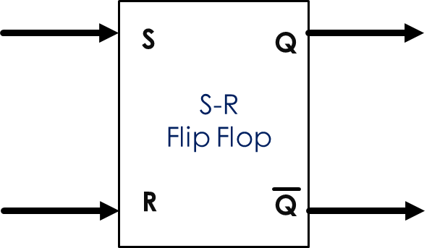
Set-Reset(S-R) Latch (NOR)
S
Block diagram of SR Latch
time
R
S | R | Q
time
0 | 0 | (Hold)
Q
0 | 1 | 0 (Reset)
time
1 | 0 | 1 (Set)
1 | 1 | Invalid
Timing diagram of a SR LATCH
Characteristics Table of SR Latch
© Adnan Amin Siddiquee

Slide 14
Gated Set-Reset(S-R) Latch (NOR)
Truth Table of AND gate
A | B | Y
0 | 0 | 0
0 | 1 | 0
1 | 0 | 0
1 | 1 | 1
R
0
E | S | R | Q
E | S | R | Q
1 | 0 | 0 | (Hold)
1
0 | 0 | 0 | (Hold)
1 | 0 | 1 | (RESET)
0 | 0 | 1 | (Hold)
1 | 1 | 0 | (SET)
0
0 | 1 | 0 | (Hold)
S
0
0 | 1 | 1 | (Hold)
1 | 1 | 1 | (INVALID)
Gated S-R Latch
Characteristics Table
© Adnan Amin Siddiquee

Slide 15
Characteristics of S-R Flip-Flop
Characteristics Table:
S-R Flip-Flop
Characteristics
Q(t) | S | R | Q(t+1)
S | R | Q
0 | 0 | Hold
0 | 1 | 0 (Reset)
1 | 0 | 1 (SET)
1 | 1 | Invalid
0 | 0 | 0
SR
0 (Hold)
Q(t)
00 01 11 10
0 | 0 | 1
 |  | x | 1
1 |  | x | 1
0 (reset)
0
1
0 | 1 | 0
1 (Set)
(Invalid)
0 | 1 | 1
1 (Hold)
1 | 0 | 0
Characteristics equation:
Q(t+1)=S+ R’Q(t)
0 (reset)
1 | 0 | 1
1 (Set)
1 | 1 | 0
1 | 1 | 1
(Invalid)
© Adnan Amin Siddiquee

Slide 16
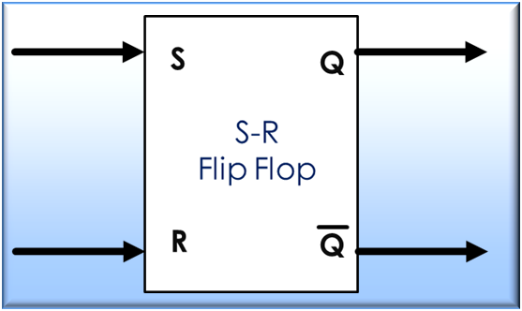
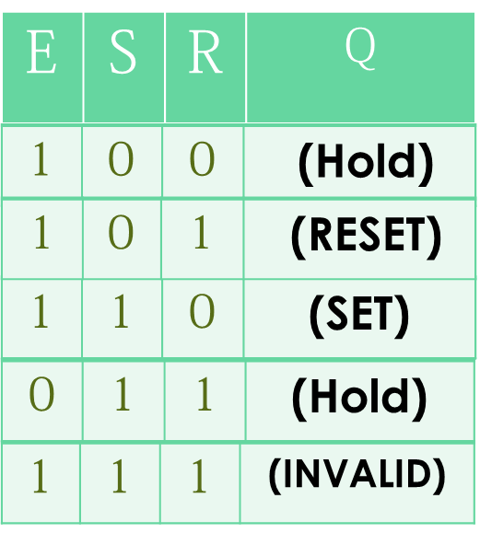
Gated Set-Reset(S-R) Latch (NOR)
E
E
Gated S-R Latch
time
S
time
R
Q
time
time
Timing diagram of a Gated SR LATCH
Characteristics Table
© Adnan Amin Siddiquee

Slide 17

J-K Flip-Flop
Modified version of S-R Flip-Flop.
Enable is replaced with clock.
Invalid Condition is removed
Figure: Logic Diagram of J-K Flip-Flop
© Adnan Amin Siddiquee

Slide 18
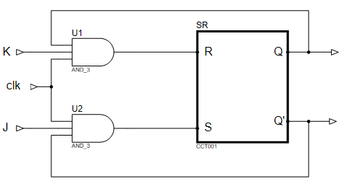
JK Flip Flop
Q
0
0
Q
1
0
Q
1
Q
1
Q
Figure: Logic Diagram of J-K Flip-Flop

Slide 19
J-K Flip-Flop (SET condition) let Q’=1
Truth Table of SR Flip Flop
0
S | R | Q
0 | 0 | Hold
0 | 1 | 0 (Reset)
1 | 0 | 1 (SET)
1 | 1 | Invalid
0
0
1
1
Q = 1
1
0
1
Figure: Logic Diagram of J-K Flip-Flop
© Adnan Amin Siddiquee

Slide 20
J-K Flip-Flop (HOLD condition) previously Q=1 Q’=0
Truth Table of SR Flip Flop
1
S | R | Q
0 | 0 | Hold
0 | 1 | 0 (Reset)
1 | 0 | 1 (SET)
1 | 1 | Invalid
0
0
0
1
0
1
1
0
0
0
0
1
0
0
Figure: Logic Diagram of J-K Flip-Flop
© Adnan Amin Siddiquee

Slide 21
J-K Flip-Flop (RESET condition) previously Q=1 Q’=0
Truth Table of SR Flip Flop
1
0
S | R | Q
0 | 0 | Hold
0 | 1 | 0 (Reset)
1 | 0 | 1 (SET)
1 | 1 | Invalid
1
1
1
1
0
1
0
1
0
0
0
0
0
Figure: Logic Diagram of J-K Flip-Flop
© Adnan Amin Siddiquee

Slide 22
J-K Flip-Flop (Toggle condition) previously Q=0 Q’=1
Truth Table of SR Flip Flop
0
S | R | Q
0 | 0 | Hold
0 | 1 | 0 (Reset)
1 | 0 | 1 (SET)
1 | 1 | Invalid
0
1
0
1
0
0
1
1
1
1
0
0
1
1
Figure: Logic Diagram of J-K Flip-Flop
© Adnan Amin Siddiquee

Slide 23
Characteristics of J-K Flip-Flop
Characteristics Table:
JK Flip Flop Characteristics
Q(t) | J | K | Q(t+1)
JK
J | K | Q
0 | 0 | Hold
0 | 1 | 0 (Reset)
1 | 0 | 1 (SET)
1 | 1 | Toggle
Q(t)
00 01 11 10
0 | 0 | 0
 |  | 1 | 1
1 |  |  | 1
0 (Hold)
0
1
0 | 0 | 1
0 (reset)
0 | 1 | 0
1 (Set)
1 (Toggle)
0 | 1 | 1
Characteristics equation:
Q(t+1)=JK+ K’Q(t)
1 (Hold)
1 | 0 | 0
0 (reset)
1 | 0 | 1
1 (Set)
1 | 1 | 0
1 | 1 | 1
0 (Toggle)

Slide 24
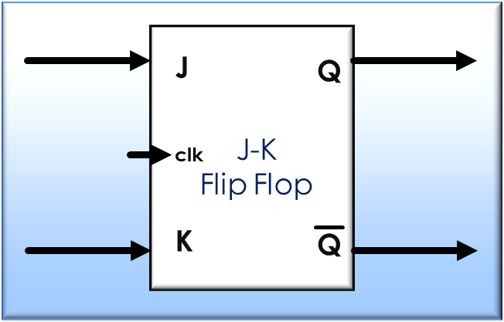
J-K Flip Flop
clk
time
Block diagram of J-K Flip Flop
J
J | K | Q
time
K
0 | 0 | (Hold)
time
0 | 1 | (Reset)
Q
1 | 0 | (Set)
time
1 | 1 | Toggle
Timing diagram of a Gated JK Flip-Flop
Characteristics table of J-K Flip Flop
© Adnan Amin Siddiquee

Slide 25
D Flip-Flop
K
J
D
Figure: Logic Diagram of D Flip-Flop
© Adnan Amin Siddiquee

Slide 26
D Flip-Flop
Characteristics table
of J-K Flip-Flop
J | K | Q
0
1
1
1
0
0 | 0 | (Hold)
K
J
0
Q
Q
Characteristics table of D Flip-Flop
J-K
Flip Flop
0 | 1 | (Reset)
clk
D | Q
1 | 0 | (Set)
1
D
0
0
1
0 | 0
1 | 1 | Toggle
1
0
1 | 1
Block diagram of D Flip Flop
N.B. INPUT AND OUTPUT SAME SO ACTS AS A BUFFER CIRCUIT
© Adnan Amin Siddiquee

Slide 27
Characteristics of D Flip Flop
D Flip Flop Characteristics
Characteristics Table:
D
D | Q
0 | 0
1 | 1
Q(t)
0 1
Q(t) | D | Q(t+1)
 | 1
 | 1
0
1
0 | 0
0
0 | 1
1
Characteristics equation:
Q(t+1)=D
0
1 | 0
1
1 | 1
© Adnan Amin Siddiquee

Slide 28
D Flip-Flop
Q
Q
D
clk
D
Flip Flop
time
clk
D
Block diagram of D Flip Flop
time
Q
Characteristics table of D Flip-Flop
D | Q
Timing diagram of a Gated D Flip-Flop
time
0 | 0
1 | 1
© Adnan Amin Siddiquee

Slide 29
T Flip-Flop
T
Figure: Logic Diagram of T Flip-Flop
© Adnan Amin Siddiquee

Slide 30
T Flip-Flop
Characteristics table
of J-K Flip-Flop
J | K | Q
0 | 0 | (Hold)
Characteristics table of T Flip-Flop
Hold
Q
Q
Toggle
0 | 1 | (Reset)
K
J
0
1
T | Q
J-K
Flip Flop
1 | 0 | (Set)
clk
1 | Toggle
1 | 1 | Toggle
0
T
1
0 | HOLD
0
1
Block diagram of T Flip Flop
© Adnan Amin Siddiquee

Slide 31
Characteristics of T Flip Flop
D Flip Flop Characteristics
Characteristics Table:
T | Q
0 | HOLD
1 | TOGGLE
Q(t) | T | Q(t+1)
T
Q(t)
0 1
 | 1
1
0 | 0
0
1
0 (HOLD)
0 | 1
1 (TOGGLE)
1 (HOLD)
1 | 0
0 (TOGGLE)
Characteristics equation:
Q(t+1) = T Q(t)’ + T’ Q(t)
1 | 1
© Adnan Amin Siddiquee

Slide 32
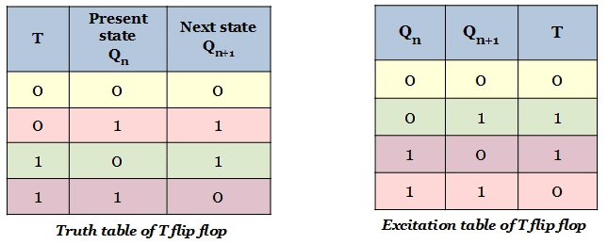
T Flip-Flop
Block diagram of T Flip Flop
Q
Q
T
T
Flip Flop
time
clk
time
Characteristics table of T Flip-Flop
T | Q
1 | Toggle
0 | HOLD
© Adnan Amin Siddiquee

Slide 33
Preset Clear J-K Flip Flop
Characteristics Table:
Preset | Clear | Q
1
0
0
1
0 | 1
1(preset)
1
1
0
0 (clear)
1 | 0
1 | 1
Q
0 | 0
Invalid
1
1
0
1
0
1
Figure: Logic Diagram of preset clear J-K Flip-Flop
© Adnan Amin Siddiquee

Slide 34
Preset Clear J-K Flip-Flop
Characteristics Table:
Preset
Preset | Clear | Q
K
J
Q
Q
0 | 1
J-K
Flip Flop
1(preset)
0 (clear)
clk
1 | 0
1 | 1
Q
0 | 0
Invalid
Clear
Block diagram of Preset Clear J-K Flip-Flop
© Adnan Amin Siddiquee

Slide 35
Race Around Condition of J-K flip-flop
Characteristics table
of J-K Flip Flop
J | K | Q
1
0
1
1
0
1
1
0
1
1 | 1 | Toggle
1
0
Characteristics Table
of SR Flip Flop
clk
1
S | R | Q
0 | 0 | Hold
0 | 1 | 0 (Reset)
1 | 0 | 1 (SET)
1 | 1 | Invalid
1
0
1
0
0
1
0
1
0
1
0
J-K Flip-Flop

Slide 36
Race Around Condition
Timing diagram showing race around condition
© Adnan Amin Siddiquee

Slide 37
Master Slave Flip-Flop
Master Slave Flip-Flop is constructed from two separate flip-flop. One serves as master another as slave.
It is used to achieve the edge trigger
It can remove the “Race Around” condition of JK flip-flop
During positive clock the Master activates and during negative clock the Slave is activated.
Master
Slave
K
J
Q
Q
Q
Q
Q
Q
K
J
K
J
J-K
Flip Flop
J-K
Flip Flop
clk
clk
Block diagram of a master-slave J-K flip-flop
© Adnan Amin Siddiquee

Slide 38
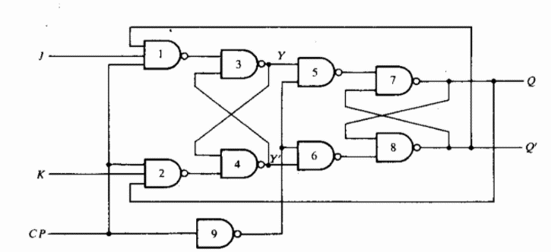
Master Slave J-K Flip-Flop
Deactivate
Active
Deactivate
MASTER
SLAVE
Active
0
1
1
0
1
Truth table of
NAND gate
1
A | B | Y
0 | 0 | 1
0 | 1 | 1
1 | 0 | 1
1 | 1 | 0
0
1
0
0
1
1
1
0
0
1
1
0
© Adnan Amin Siddiquee

Slide 39
Any Question
© Adnan Amin Siddiquee

Slide 40
The
End
© Adnan Amin Siddiquee

